Slide 1
Naming
Chapter 5
Notes:
单机文件系统：命名，磁道
个人命名：地址
物理资源，逻辑资源

Slide 2
Outline
Names Entities
Flat Naming
Structured Naming
Attribute-Based Naming
Notes:
flat names are good for machines, but are generally not very convenient for humans to use. As an alternative, naming systems generally support structured names that are composed from simple human readable names.
Finally, humans often prefer to describe entities by means of various characteristics, leading to a situation in which we need to resolve a description by means of attributes to an entity adhering to that description. This type of name resolution is notoriously difficult and we will pay separate attention to it.

Slide 3
Names Entities
What do names do?
identify objects
help locate objects
define membership in a group
specify a role
convey knowledge of a secret
……
Name space
defines set of possible names, consists of a set of name to value bindings; 表示一个标识符(identifier)的可见范围。一个标识符可在多个名字空间中定义，它在不同名字空间中的含义是互不相干的。比如学号、车牌号等；
Notes:
命名解析：允许一个进程去访问一个命名的个体
学号，车牌号；

Slide 4
Entities, Names, IDs, and Addresses
A name is a sequence of bits that can be used to refer to an entity. (Names are in theory unique, but in practice maybe not. DNS name.)
Entities: The “thing” that we want to refer to.
What properties are desired in name?
Location independence
Easy to remember
Notes:
分布式系统中的几个重要概念：
分布式系统中：指代资源，物理资源，逻辑资源；
实体：可以被操作，提供操作接口；举例：打印机提供操作接口
和位置无关：和地址对比；
Good properties might be readability, if used by humans. Error-checking is for credit card numbers. Ability to do transport for addresses.

Slide 5
Entities, Names, IDs, and Addresses
To operate on an entity, necessary to access it, via an access point（addresses）.
Can an entity have more than one access point?
Can an entities access point change over time?
Are names unique? Permanent?
Addresses unique? Permanent?
Notes:
access point：特殊实体，名字为address（IP+端口号）
一个实体可以有多个access point：一人，多个电话号码；
可以更换：电话号码；

Slide 6
Name Types
Identifier: unambiguously refers to an entity(1 to 1)
Address: access point
Human Friendly Name：
a name tailored to be used by humans, often a character string
Properties
Names versus addresses
Location transparent versus location-dependent
Flat versus hierarchical：name assignment vs name resolution
Global versus local
Absolute versus relative
Unique versus ambiguous
Notes:
三种命名：
Identifier：唯一标识实体，bit串
Address：地址（特殊实体），bit串，机器可理解
Human Friendly Name：实体，有语义的字符串
Global versus local ？？？
Absolute versus relative？？？
命名解析：从名字映射为地址

Slide 7
Fundamental Tricotomy(三分法)
Names
Addresses
Routes(sometimes called paths)
Example — a Person
Name — Jonathan M. Smith
Address — 123 Park St., Andover, MA
Route —
From Andover center, go west 1.2 miles
Turn right, then take 3rd left
He lives at the 2nd house on the right
Notes:
命名组合描述实体：

Slide 8
Example — a File
Name — index.html
Address — inode #54321
Route (path) —
/csopt1/cs4513/public_html/d07/index.html
Example — a Web Page
Name — CS-4513 Home Page
Address — inode #54321
Route — http://www.cs.wpi.edu/~cs4513/d07
Example — Remote Object
Name — Gutenberg (a print server)
Address — ???
Route —rmi://garden.wpi.edu:1099/Gutenberg
Notes:
Address — inode #54321？？？

Slide 9
Names vs. Addresses
When you hand a name to a naming system to resolve, it must look it up to find the corresponding object or entity
When you hand an address to a system, it already knows how to find it. E.g., and IP address
When you hand a path (i.e., a route) to a system, you are giving it a sequence of things it knows how to find
Step-by-step
Iterative or recursive follow
Unix/Linux file names
URL’s on the World Wide Web
Types and objects in a C++ or Java program
Computers attached to the Internet
…
Naming Systems we all know
Notes:
命名解析：允许一个进程去访问一个命名的个体；
命名解析：从名字映射为地址
命名
命名系统：实现命名与名字解析
透明性：分布式系统要解决的问题
命名系统

Slide 10
Name Spaces
命空间是一个系统中所有名字的集合，表示一个标识符的可见范围，例如:
Phone numbers
Human names in the China
DNS
Files in UNIX, Windows
Credit card numbers
Robert Ludlum books
URLs
A name space can be represented as a labeled, directed graph with two types of nodes(带有标注的具有两种类型的节点的有向图).
Notes:
分布式系统的名称都组织在通常所说的名称空间（name space）中。名称空间可以表示为带有标注的具有两种类型的节点的有向图。

Slide 11
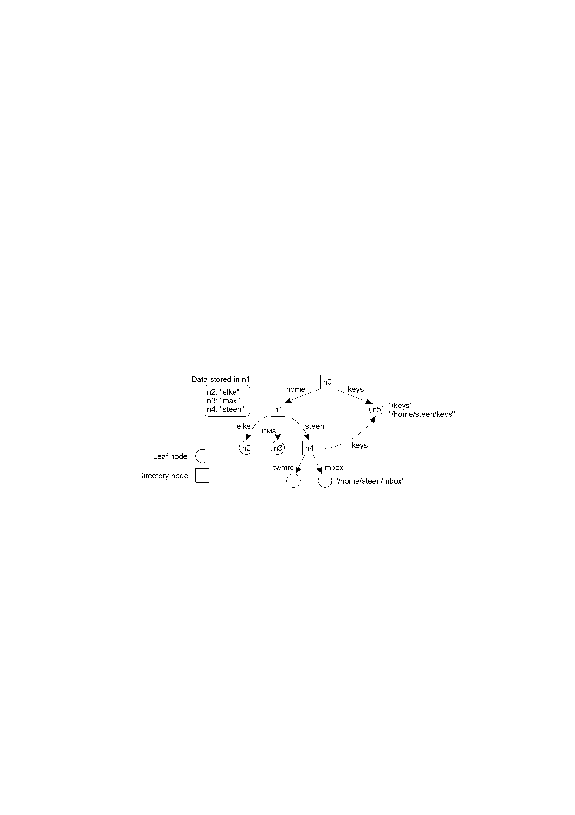
Name Space
A graph in which a leaf node represents a (named) entity. A directory node is an entity that refers to other nodes.
Note: A directory node contains a (directory) table of (edge label, node identifier) pairs.
Notes:
每个节点有一个identifier；一个identifier对应一个name；
叶子节点：带名字的一个实体；无输出边；
存储内容：所代表实体的信息：地址，状态；
目录节点：输出边：每个边表示一个名字；映射目录；（根节点）
路径：路径名：某个节点的identifier打头，后边各边名字连接；
相对路径名；绝对路径名；
每个节点有唯一的绝对路径名；
路径，相对名称，绝对名称；
Path, local name, absolute name
Should it be a tree, DAG(Directed acyclic graph), allow cycles?
Cycles might be convenient, if we want to order things more.
Tree will prevent multiple names.

Slide 12
Example: UNIX(linking and mounting within a single name space)
Name resolution---The process of looking up a name.
for example, UNIX
1) /user/zhang/sub
2) ./sub
Closure(闭合) mechanism---knowing how and where to start name resolution.
(for example, the i-node of the root directory in UNIX)
Notes:
命名空间的目的：提供一种机制，以支持按照名字查找对应实体的信息（地址，状态，，，），给出一个路径名，找到这个名字对应的实体的信息；
举例： 从第一个block，boot block开始查找

Slide 13
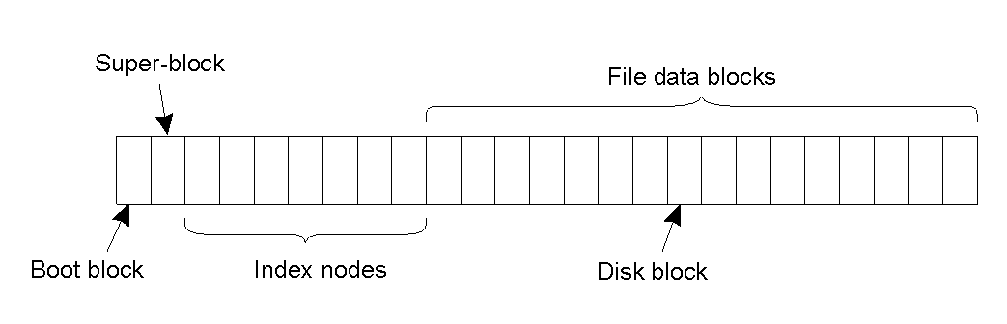
Example: UNIX(linking and mounting within a single name space) there are different ways to organize a name space
The general organization of the UNIX file system implementation on a logical disk of contiguous disk blocks.
Notes:
index node：inode；索引具体文件内容
boot block：默认系统启动时自动加载入内存；
super block：整体文件系统的描述；

Slide 14
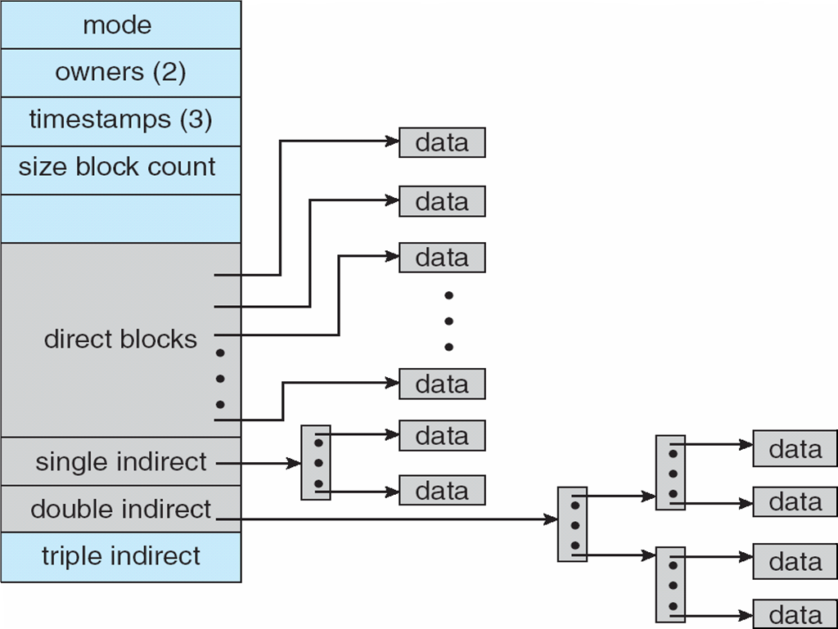
UNIX给定文件路径名／usr／ast／mbox，解析过程如下:
132#块是/usr的目录
根目录
406#块是/usr/ast的目录
结点6是
／usr的目录
1
1
4
7
14
9
6
8
.
..
bin
dev
lib
etc
usr
tmp
结点26是/usr/ast目录
6
1
19
30
51
26
45
.
..
disk
erik
jim
ast
bat
26
6
64
92
60
81
17
.
..
grants
books
mbox
minix
src
132
406
Notes:
？？？

Slide 15
Linking and Mounting(name resolution can also be used to merge different name space in a transparent)
Mount point—the directory node storing the node identifier.
Mounting point (被安装点)—the directory node in the foreign name space (root node).
To mount a foreign name space in a distributed system requires at least the following information:
1. The name of an access protocol.
2. The name of the server.
3. The name of the mounting point in the foreign name space.
(None of the three points may be needed in nondistributed system, for example, in UNIX, no 1 and 2, root is the mounting point)
Notes:
mounting point一般是
需要解析：
1. The name of an access protocol：protocol的具体实现
2. The name of the server：server（实现foreign name space）的地址
3. The name of the mounting point in the foreign name space：mounting point的identifier

Slide 16
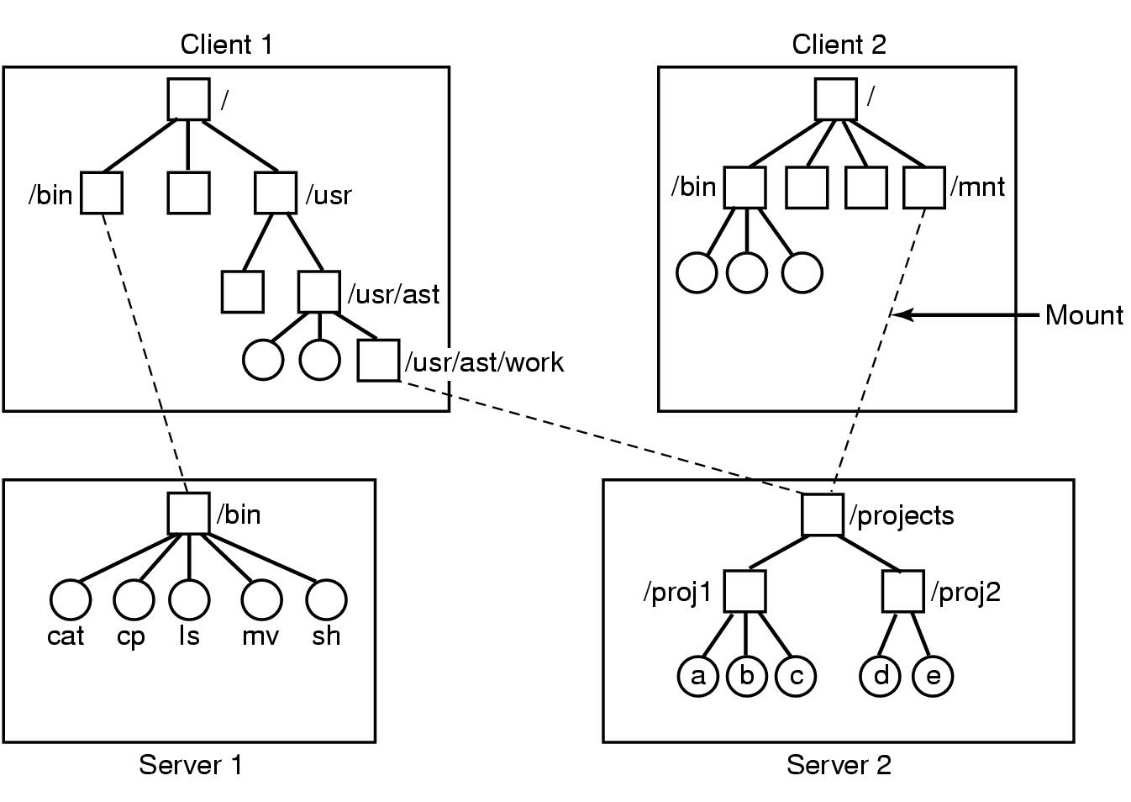
Example
Notes:
命名解析举例：
远程透明文件系统命名解析：
叶子节点：绝对路径地址；

Slide 17
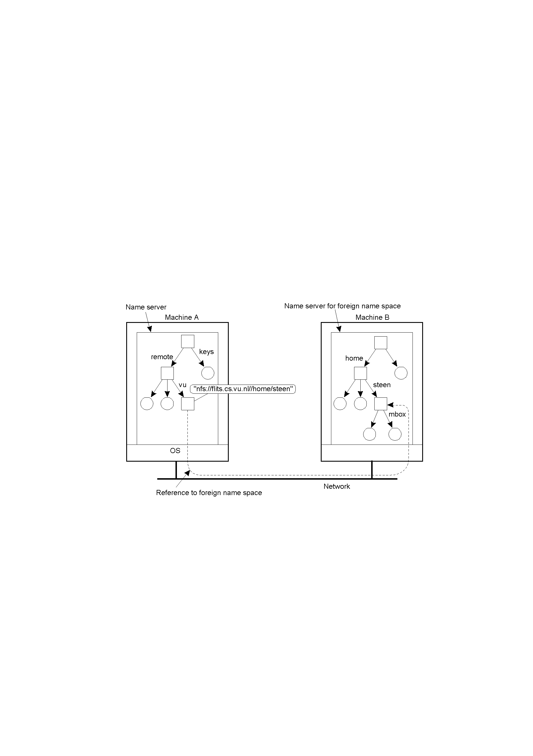
Mounting a remote file system (in distributed file system)
(Protocol, Server, Mounting point)
Mounting remote name spaces through a specific process protocol.
(in NFS)
Notes:
nfs:WWW中公认的nfs通信协议；
server：DNS服务找到具体地址；
/home/steen：交由对方server解析；第一个是根目录节点
解析工作由分布式系统完成，上层client看到两个命名空间是一体的，透明性；

Slide 18
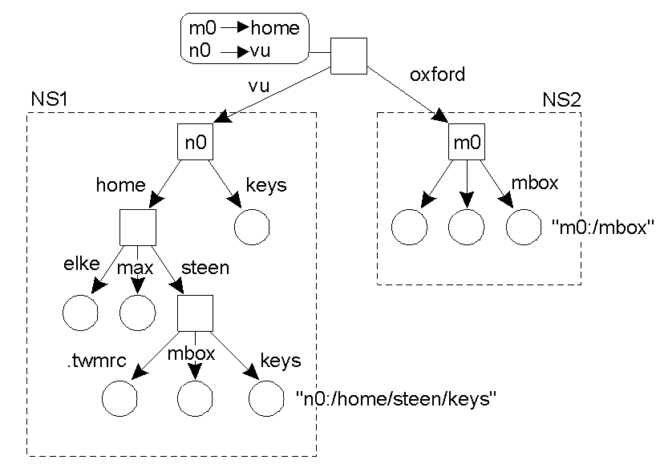
Linking and Mounting (3) 另一种Mounting方式(DEC’ GNS)
oxford
增加新的Root结点,并使老的Root结点变为其子结点;
变为:/vu/home/steen/keys
Organization of the DEC Global Name Service
(to add a new root node and to make the existing root nodes its children)
Notes:
另一种方式：合并；
问题：需要改名：绝对路径：默认根目录节点变为子节点：名字变为vu；前边加新的默认根节点

Slide 19
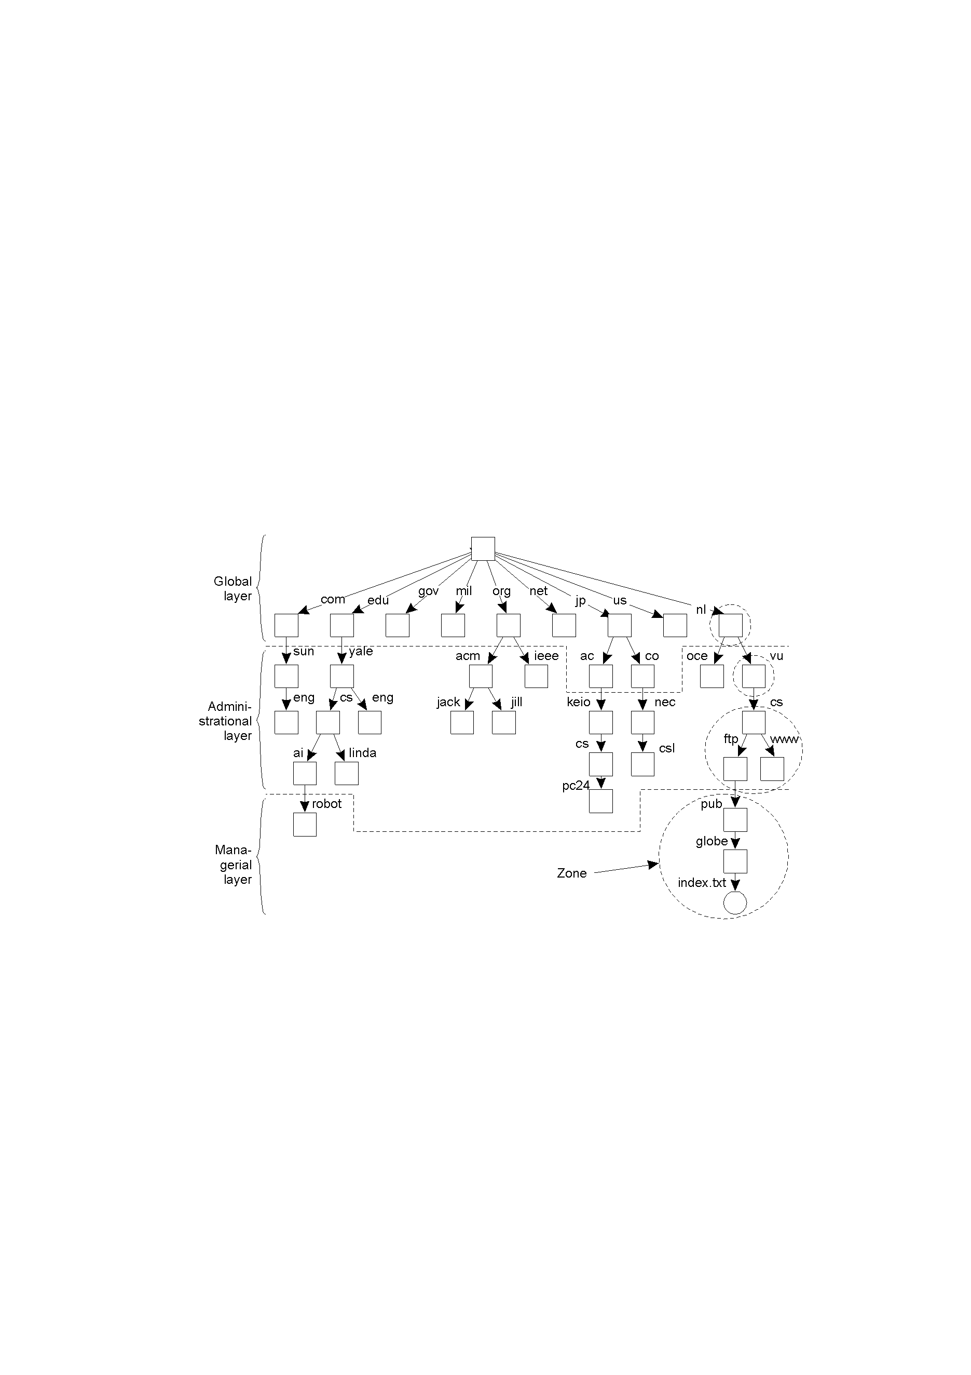
Name Space Distribution
The DNS name space is hierarchically organized as a rooted tree. Each node in the DNS name space has exactly one incoming edge.
An example partitioning of the DNS name space, including Internet-accessible files, into three layers.
Notes:
命名空间（数据结构）是命名系统服务的核心：允许用户增，删，查找名字；一个命名服务由一群命名server构成；
large-scale：分层组织；实例：DNS命名服务；
查找实例：

Slide 20
Three layers
The global layer is formed by highest-level nodes, Such nodes may represent organizations, or groups of organizations (stability,某类组织).
The administrational(机构组织层) layer is formed by directory nodes that together are managed within a single organization.
The managerial layer consists of nodes that may typically changed regularly. for example, host.
Item | Global | Administrational | Managerial
Geographical scale of network | Worldwide | Organization | Department
Total number of nodes | Few | Many | Vast numbers
Responsiveness to lookups | Seconds | Milliseconds | Immediate
Number of replicas | Many | None or few | None
Update propagation | Lazy | Immediate | Immediate
Is client-side caching applied? | Yes | Yes | Sometimes
A subtree is called a domain（逻辑上）; A zone is a part of the name space that is implemented by a separate name server（名字服务器，物理上授权）；
例如 berkeley 域（Domain）是所有以 berkeley.edu 结尾的域名空间；而 edu zone 可以包括 berkeley 和 purdue 两个域，都统一归 edu 这个 zone 管理。
Notes:
Responsiveness to lookups：Global：因为可以cache，所以查询速度不需要太快
Number of replicas：上层需要可用性；
域和domain的区别？

Slide 21
Outline
Names Entities
Flat Naming
Structured Naming
Attribute-Based Naming
Notes:
flat names are good for machines, but are generally not very convenient for humans to use. As an alternative, naming systems generally support structured names that are composed from simple human readable names.
Finally, humans often prefer to describe entities by means of various characteristics, leading to a situation in which we need to resolve a description by means of attributes to an entity adhering to that description. This type of name resolution is notoriously difficult and we will pay separate attention to it.

Slide 22
Flat Naming
Problem: Given an essentially unstructured name (e.g., an identifier), how can we locate its associated access point(addresses)?
Simple solutions:
broadcasting;
Forwarding pointers);
Home-based approaches;
Distributed Hash Tables

Slide 23
Simple Solusions
Broadcasting: Simply broadcast the ID, requesting the entity to return its current address.
Can never scale beyond local-area networks
Requires all processes to listen to incoming location requests
例如：Internet ARP(Address Resolution Protocol) /RARP，Reverse Address Resolution Protocol），IP与 MAC地址互转换，可以广播方式。机器在本网中广播一个数据包，以查找拥有指定IP地址的机器，或者反之。
Notes:
给出IP地址，查找MAC地址；

Slide 24
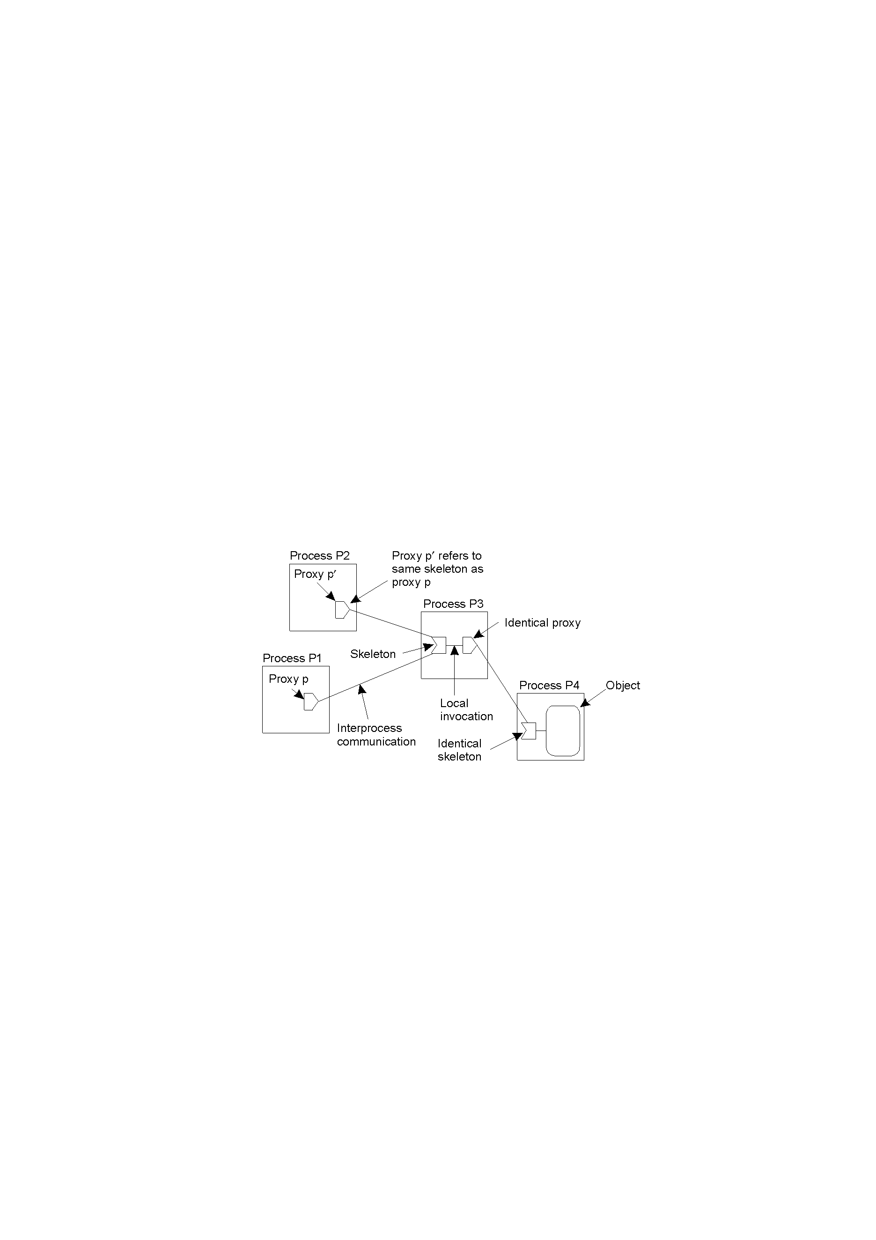
Forwarding Pointers
Forwarding pointers: Each time an entity moves, it leaves behind a pointer telling where it has gone to.
Dereferencing(间接引用) can be made entirely transparent to clients by simply following the chain of pointers; Update a client’s reference as soon as present location has been found;
The principle of forwarding pointers using (proxy, skeleton) pairs.
Notes:
分布式对象；
透明性：client stub和server stub；

Slide 25
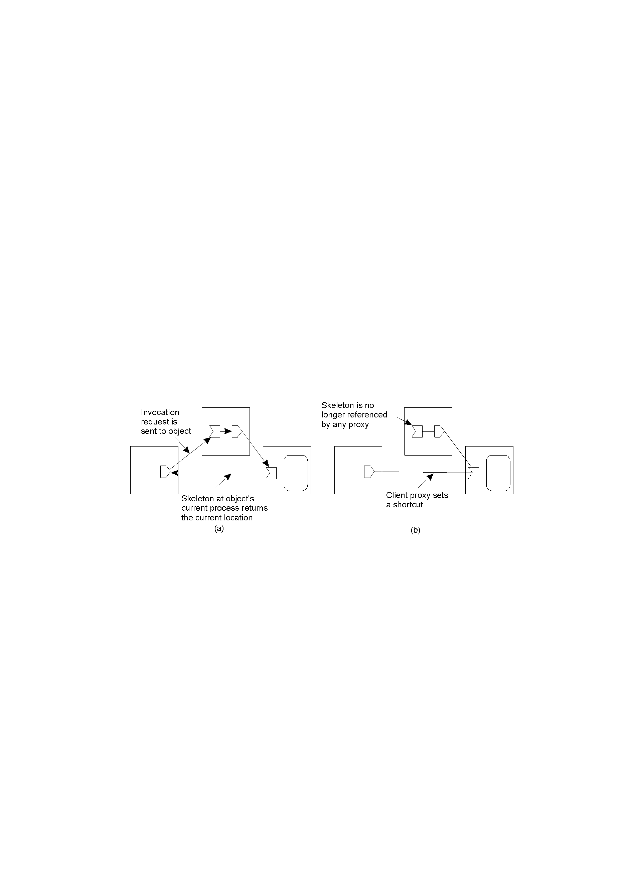
Forwarding Pointers (2)
Geographical scalability problems:
Long chains are not fault tolerant
Increased network latency at dereferencing
Essential to have separate chain reduction mechanisms(还原机制)
Redirecting a forwarding pointer, by storing a shortcut in a proxy.

Slide 26
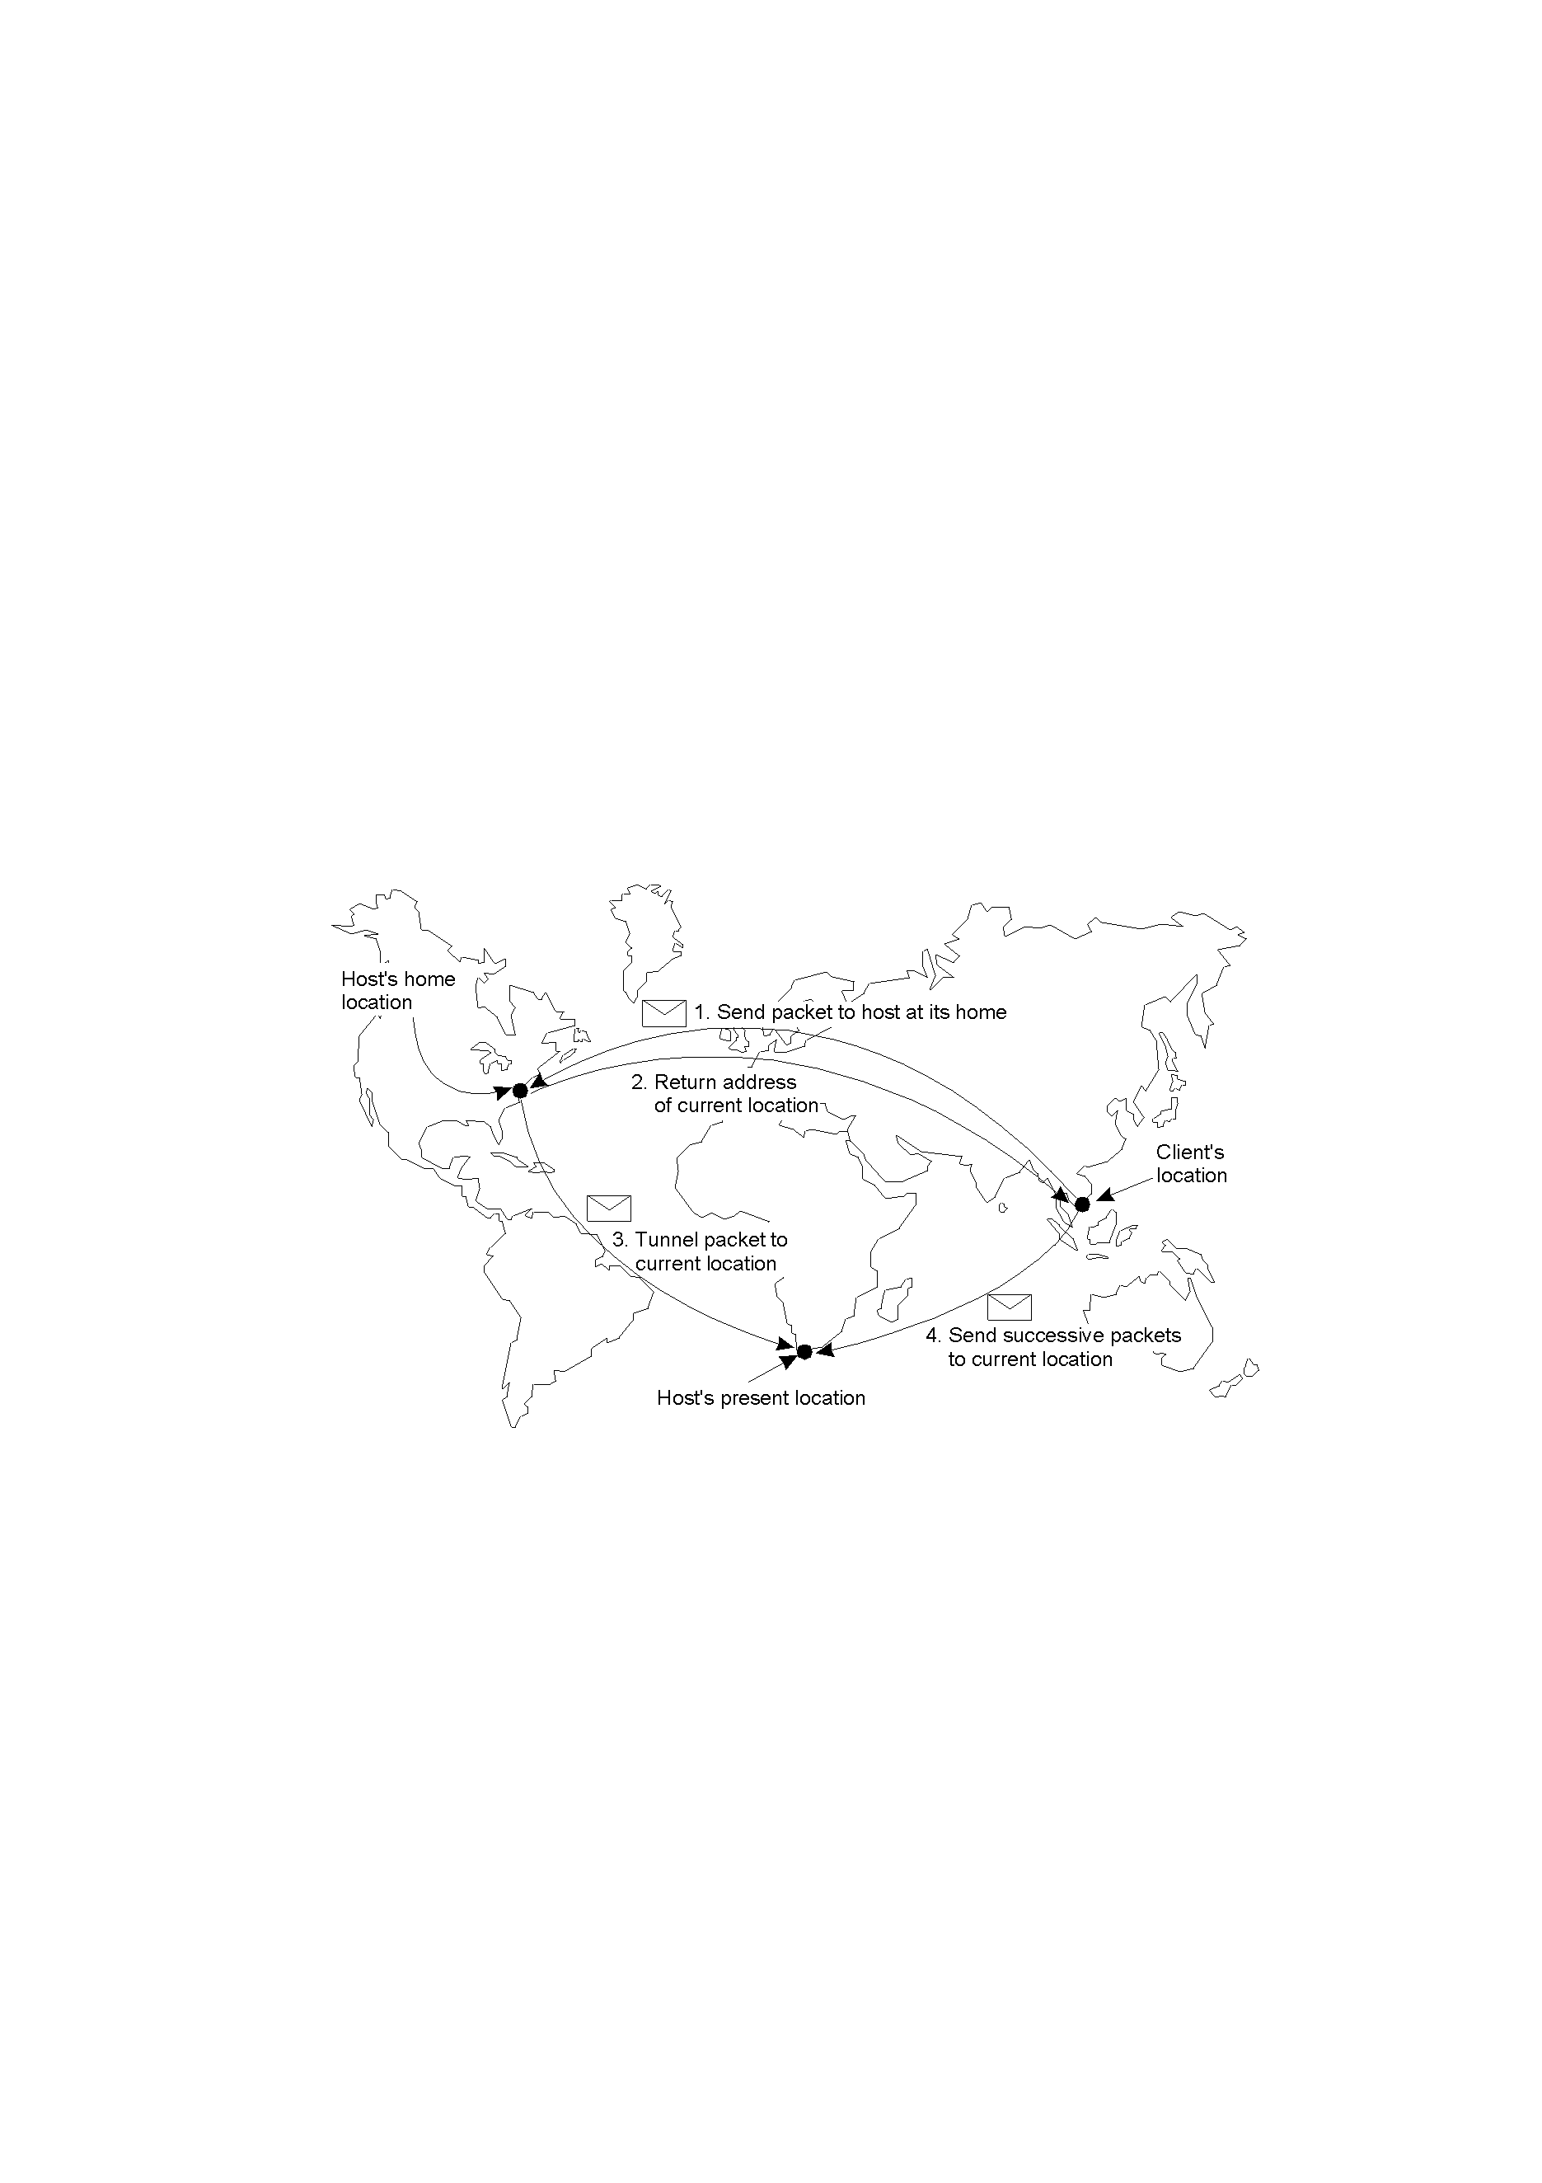
Home-Based Approaches
Single-tiered scheme: Let a home keep track of where the entity is:
An entity’s home address is registered at a naming service
The home registers the foreign address of the entity
Clients always contact the home first, and then continues with the foreign location(假设每个实体都有一个HOME)
Notes:
已有方案：分布式；
开销问题；
home方案：集中式；keep track

Slide 27
Home-Based Approaches (2)
Problems with home-based approaches:
The home address has to be supported as long as the entity lives.
The home address is fixed, which means an unnecessary burden when the entity permanently moves to another location
Poor geographical scalability (the entity may be next to the client实体可能就靠近客户)
naming service
home
home
permanent move
How can we solve the “permanent move” problem?
Register the home at a traditional naming service and to let a client first look up the location of the home
Notes:
A solution to this problem is to register the home at a traditional naming service and to let a client first look up the location of the home. Because the home location can be assumed to be relatively stable, that location can be effectively cached after it has been looked up.

Slide 28
Distributed Hash Tables
Balakrishnan etc.2003. Commun. ACM. 提出了DHT.
Example: Consider the organization of many nodes into a logical ring (Chord Project at MIT)每个结点存储一部分数据和负责一部分路由，从而实现整个网络的寻址和存储；
Supports only one Operation：node = lookup(Key)
Use some hashing function to map nodes and object Ids into one namespace()
Modulo divide the key to get a circular structure (key/modulo)
1
2
5
3
Simple, elegant and powerful(logN)
Related issues involve:
Load Balancing
Security
4
Nodes
Items
Notes:
实体：数据
命名：key，实体内容：value；

Slide 29
Chord - Search
Every node n knows about Successor(n)
but is this enough ?
Only node 0
Routing table shown
0
7
1
Routing table size: 1
Chord - Complete Routing
6
2
Routing table(finger table)
table size: M(2的M次方),
where N = 2^{M}
Every node n knows successor(n + 2 ^{i-1}) , for i = 1..M
3
5
4

Slide 30
DHTs: Finger Tables (1)
Princeple：Each node p maintains a finger table FT_{p}[] with at most m entries: FT_{p}[i] = succ(p + 2^{i−1}) 以2为底的指数增长
Note: FT_{p}[i] points to the first node succeeding p by at least 2^{i−1}.
(指向从2^{i−1}节点开始向后的第一个可用结点, 有些结点不可用)
To look up a key k, node p forwards the request to node with index j satisfying(为查找k，结点p将请求转发给索引为j的结点,且满足）
q = FT_{p}[j] ≤k < FT_{p}[j + 1] （快速确定范围）
If p < k < FT_{p}[1], the request is also forwarded to FT_{p}[1]

Slide 31
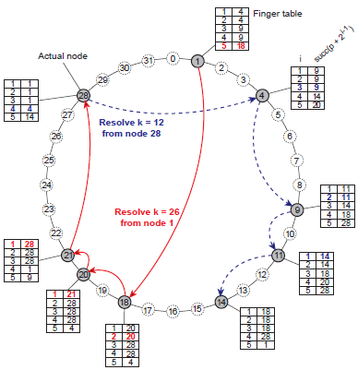
DHTs: Finger Tables (2)
由32个结点组成的名空间，32=2⁵ ，表长度m=5，FT_{p}[i]项指向从2^{i−1}节点开始向后的第一个可用结点。节点4为例后续可用节点为9:
FT₄[1] = 4+ 2¹⁻¹ = 9（5）
FT₄[2] = 4+ 2²⁻¹ = 9（6）
FT₄[3] = 4+ 2³⁻¹ = 9 （8）
FT₄[4] = 4+ 2⁴⁻¹ =14（12）
FT₄[5] = 4+ 2⁵⁻¹ =20 （20）
节点1要查找键值k =26，结点1将请求转发给指状表中索引为j的结点,且满足
（ FT_{p}[j] ≤k < FT_{p}[j + 1]）。
FT₂₈[i] = ?
Notes:
开放环境，有些节点退出，故障，新加入；
一个用户可以联系任意一个节点开始查找；
数据切片思想；
跳表思想；

Slide 32
DHTs: Finger Tables (3)
Chord提供的应用接口：
Lookup(k)
Insert(k,v)
Update(k,new-v)
Jion(NID)
Leave()
可以证明: 结点数为N的系统，查找时间复杂度为O(log(N));
结点加入/离开: 加入的结点可与系统中任意结点联系，请求查找succ(p + 1), 标示后即可插入;
系统复杂性在于指状表的更新，每个结点q定期运行一个进程与succ( q + 1)联系，并请求返回pred(succ( q + 1))。如果q= pred(succ(q + 1))，则一致，否则，需要进行调整;
DHT在P2P研究和应用上具有重要作用。
Notes:
节点加入，节点离开；
Succ如何实现就需要另外一套机制，网络层做的事情；

Slide 33
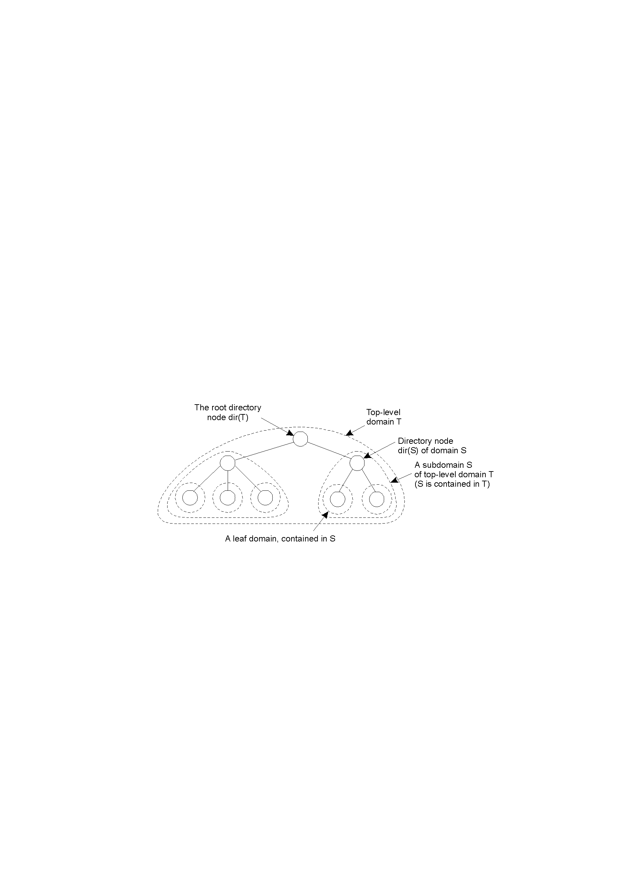
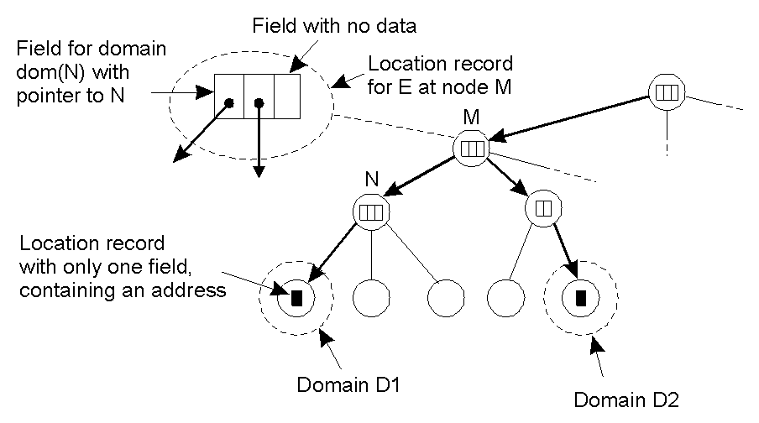
Hierarchical Location Services (HLS)
Hierarchical organization of a location service into domains, each having an associated directory node.
（组织成域，每个域有一个目录节点）。
An example of storing information of an entity having two addresses in different leaf domains.
(每个域结点包含下属每个实体位置,M)
Notes:
域：社会层级管理结构
实体：命名：唯一标识
叶子域：区域网或者基站；包含多个实体；
每个域一个目录节点；包含了该域下的所有实体位置；
目录节点：该域中所有实体都对应一个记录；
一个实体会在多个域的目录节点中出现；
叶子域目录节点：一个记录：（实体名，实体的地址）
其他域目录节点：一个记录：（实体名，指针：指向该实体所在叶子域）

Slide 34
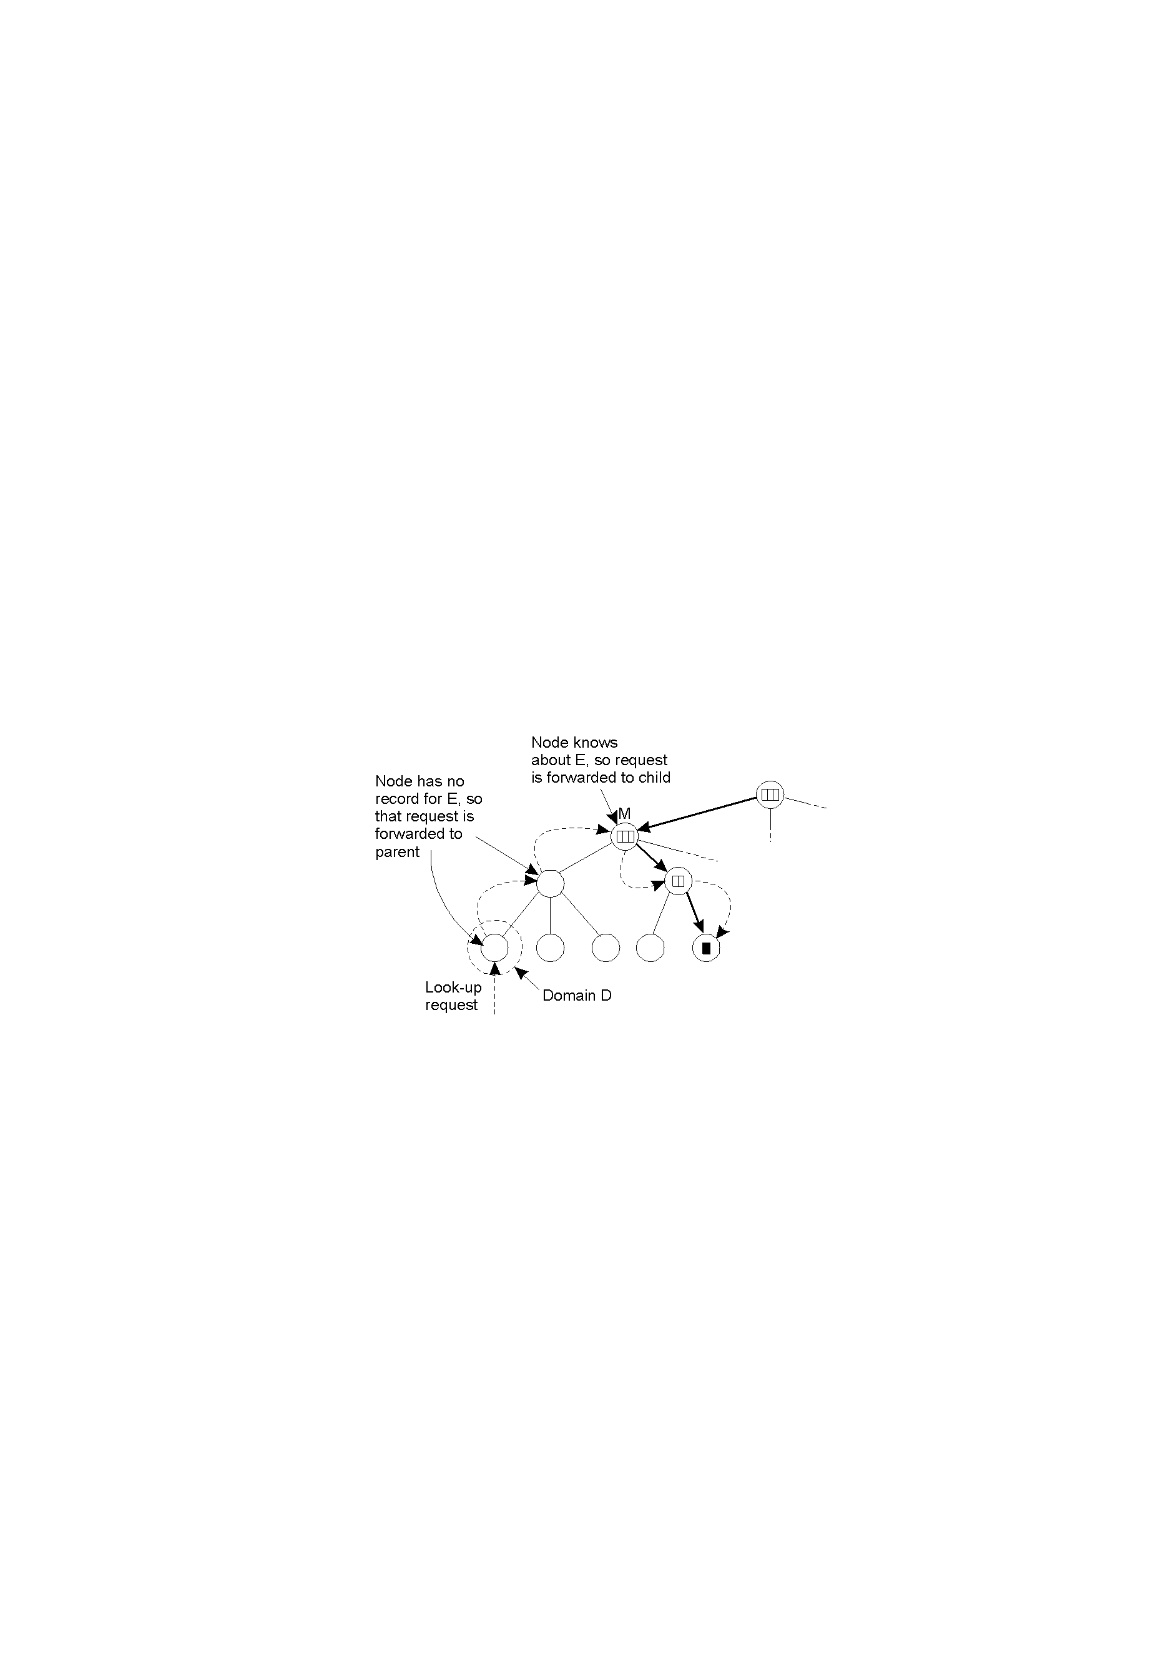
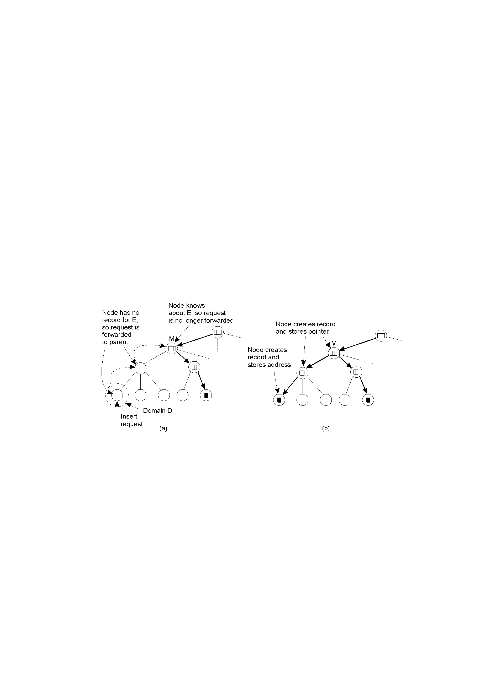
Hierarchical Location Services (HLS)
Looking up a location in a hierarchically organized location service（查找过程）
An insert request is forwarded to the first node that knows about entity E.(插入E的过程)
A chain of forwarding pointers to the leaf node is created.（创建指向新节点的链）

Slide 35
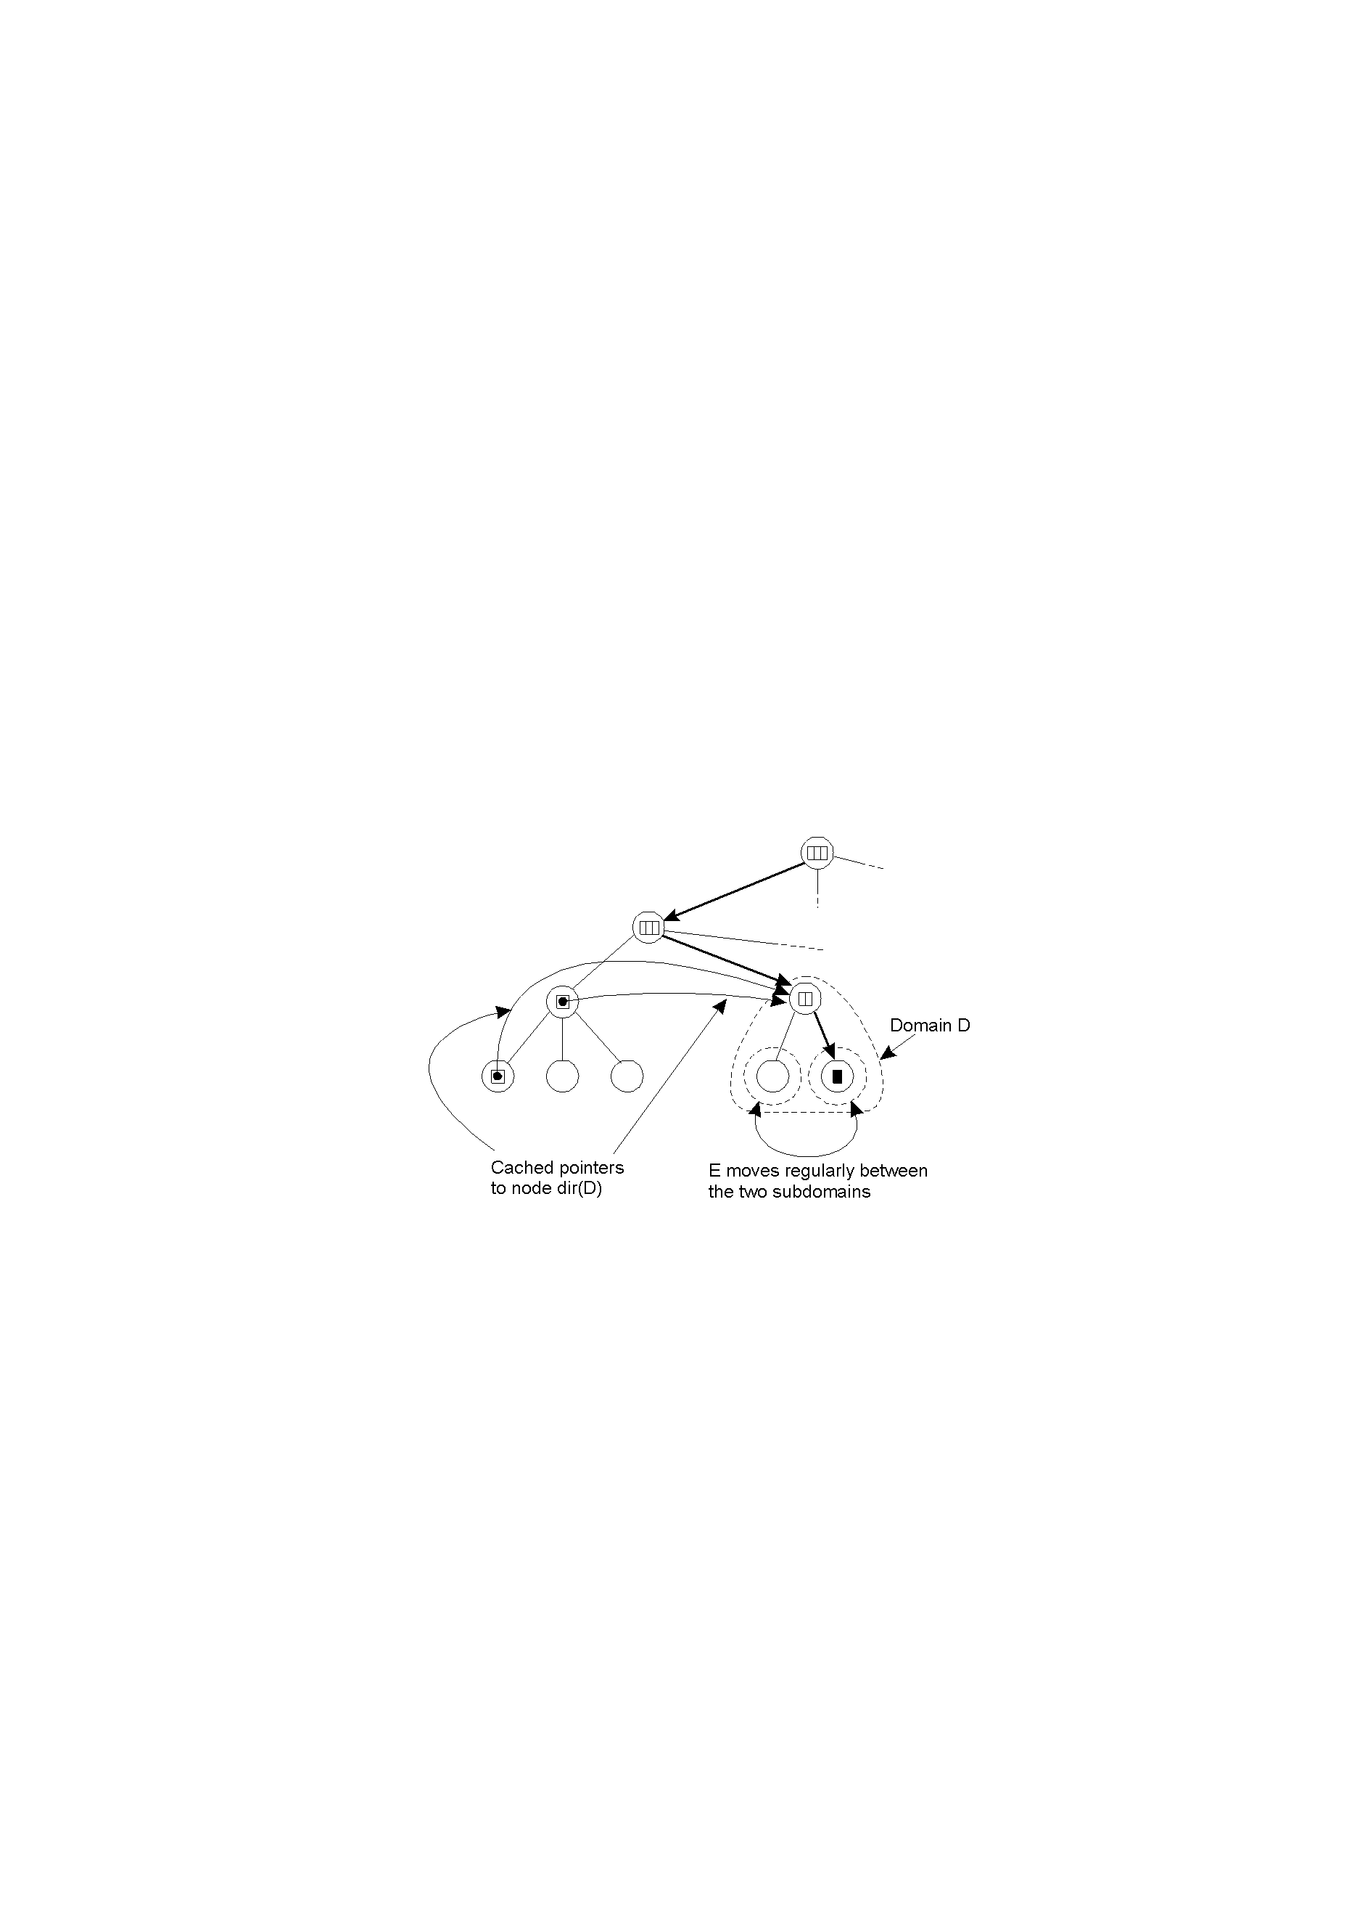
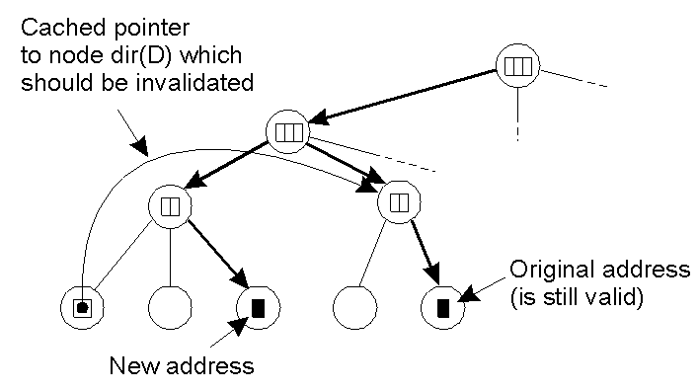
Pointer Caches (1) 通过缓存引用来提高定位效率
Caching a reference to a directory node of the lowest-level domain in which an entity will reside most of the time.
A cache entry that needs to be invalidated because it returns a nonlocal address, while such an address is available.
问题：什么时候让缓存失效？例如建立了new address.
Notes:
支持移动实体；
在查找路径上缓存；

Slide 36
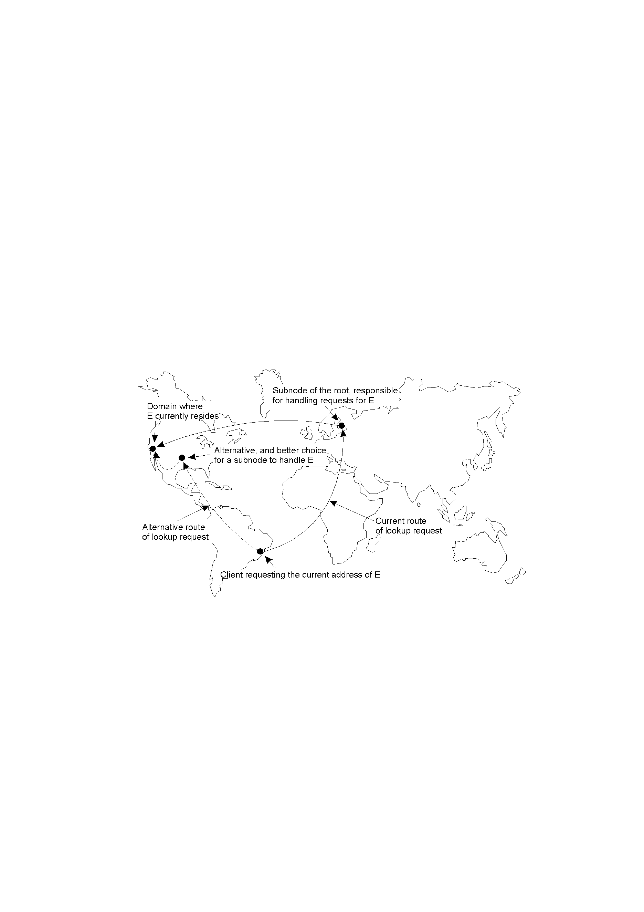
Scalability Issues
根节点需要存储所有实体的位置记录，以及一个或多个指向较低层目录结点的指针，需要处理太多的查找和更新请求，会成为瓶颈。
一种方法将根结点分成多个子结点。问题：让哪一个子结点处理哪个实体？
通信代价高
通信代价低
The scalability issues related to uniformly placing subnodes of a partitioned root node across the network covered by a location service.
在定位服务覆盖网上均匀的放置子结点
Notes:
分片：
集中式数据中心：网络拥塞
分散式：哪个子节点存储哪个请求？

Slide 37
Outline
Names Entities
Flat Naming
Structured Naming
Attribute-Based Naming
Structured Naming
Hierarchical Location Services
The Implementation of a Name Space
Example: UNIX,The Domain Name System (++)
Notes:
flat names are good for machines, but are generally not very convenient for humans to use. As an alternative, naming systems generally support structured names that are composed from simple huamn readable names.

Slide 38
Name Space
A graph in which a leaf node represents a (named) entity. A directory node is an entity that refers to other nodes.
Note: A directory node contains a (directory) table of (edge label, node identifier) pairs.
Notes:
域：社会层级管理结构
每个节点有一个identifier；一个identifier对应一个name；
叶子节点：带名字的一个实体；无输出边；
存储内容：所代表实体的信息：地址，状态；
目录节点：输出边：每个边表示一个名字；映射目录；（根节点）
路径：路径名：某个节点的identifier打头，后边各边名字连接；
相对路径名；绝对路径名；
每个节点有唯一的绝对路径名；用作实体的命名，可唯一标识；
Path, local name, absolute name
Should it be a tree, DAG(Directed acyclic graph), allow cycles?
Cycles might be convenient, if we want to order things more.
Tree will prevent multiple names.

Slide 39
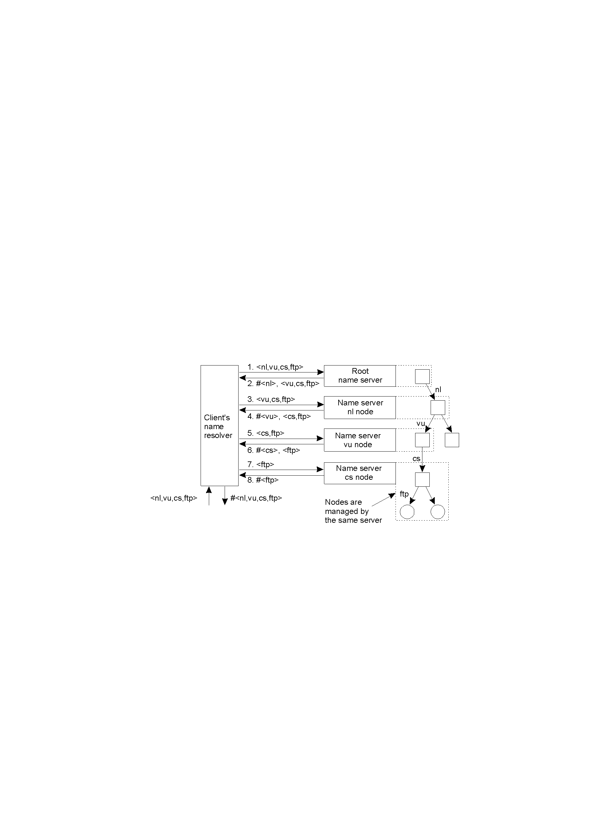
Implementation of Name Resolution
There are two ways to implement name resolution:
1. Iterative name resolution
2. Recursive name resolution
The principle of iterative name resolution.

Slide 40
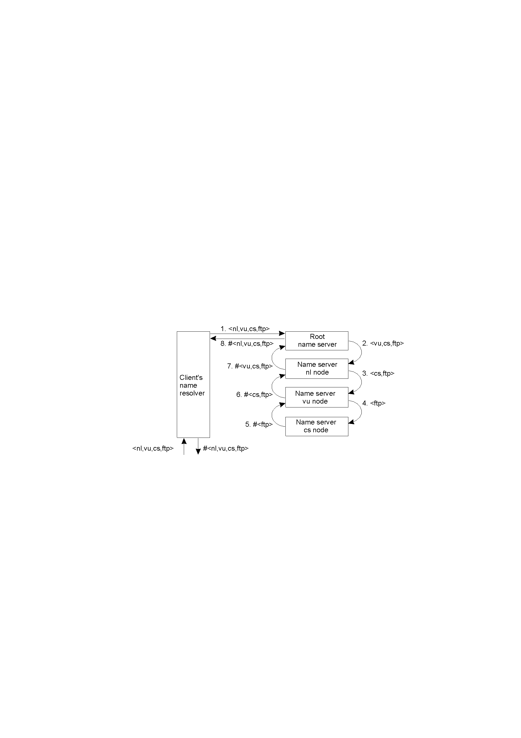
Implementation of Name Resolution (2)
The principle of recursive name resolution.
Notes:
直接知道ftp地址是否就可以直接去访问了？

Slide 41
Implementation of Name Resolution (3)
Server for node | Should resolve | Looks up | Passes to child | Receives and caches | Returns to requester
cs | <ftp> | #<ftp> | -- | -- | #<ftp>
vu | <cs,ftp> | #<cs> | <ftp> | #<ftp> | #<cs> #<cs, ftp>
nI | <vu,cs,ftp> | #<vu> | <cs,ftp> | #<cs> #<cs,ftp> | #<vu> #<vu,cs> #<vu,cs,ftp>
root | <nl,vu,cs,ftp> | #<nl> | <vu,cs,ftp> | #<vu> #<vu,cs> #<vu,cs,ftp> | #<nl> #<nl,vu> #<nl,vu,cs> #<nl,vu,cs,ftp>
Recursive name resolution of <nl, vu, cs, ftp>. Name servers cache intermediate results for subsequent lookups.

Slide 42
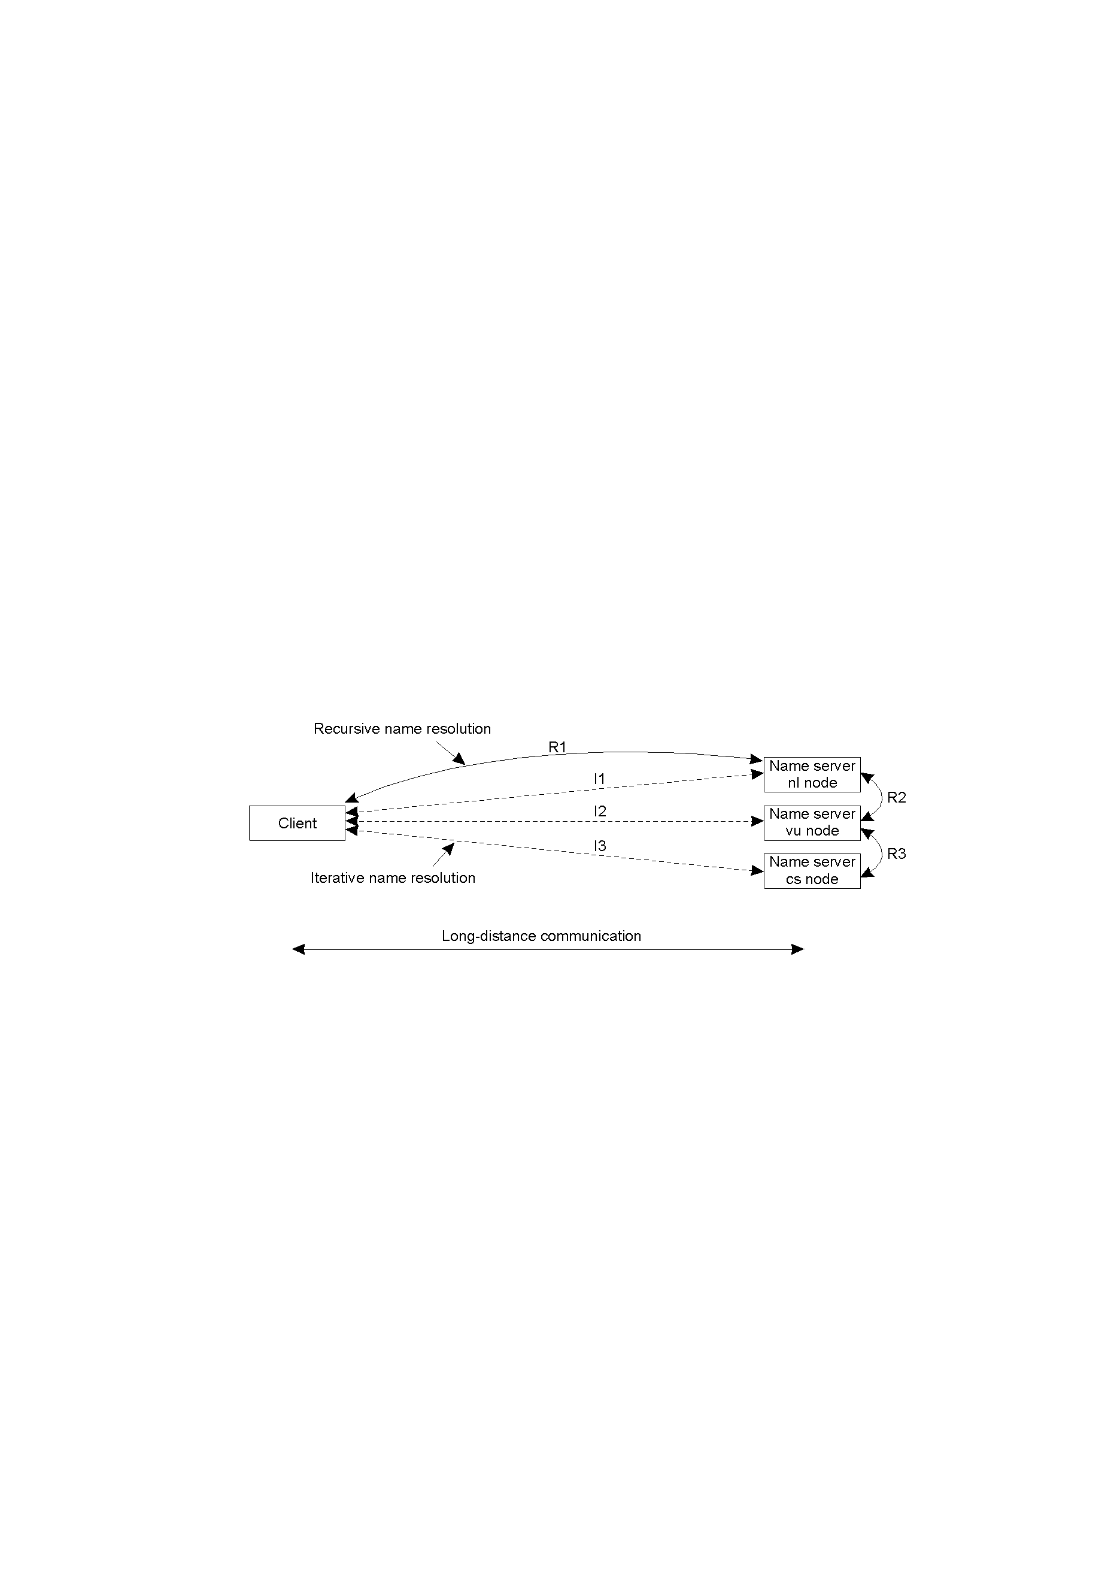
Implementation of Name Resolution (4)
The comparison between recursive and iterative name resolution with respect to communication costs.

Slide 43
Example: The Domain Name System
The Internet Domain Name System(DNS) is the largest distributed naming services in use today. 它为互联网上的每个实体起个独一无二的名字，并能够通过名字查找其在“网图”中的位置。
DNS将整个Internet视为一个域名空间（Name Space）, 域代表网络中命名资源的集合，资源包括工作站、PC机、路由器等任何标识的东西；
域名服务器负责管理存放主机名和IP地址的数据库文件，以及主机名和IP地址映射。它们分布在不同地方，通过特定方式进行联络；

Slide 44
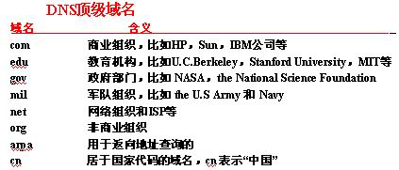
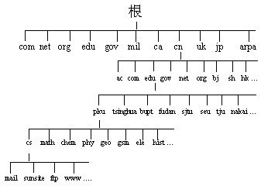
Example: The Domain Name System
Domain Name域名（ a path name to its root node）——公司在网上的唯一标识；例如：学校域名 www.xjtu.edu.cn
主机名的书写方法: 叶节点名.三级域名.二级域名.顶级域名

Slide 45
Example: The Domain Name System
DNS域名服务采用C/S的查找模式，查找“ftp.cdrom.com”的IP地址：
（1）本地域名服务器查找缓存中的域名信息:
如果有，服务器进程就将结果返回给客户程序；
若没有，则本地域名服务器会询问其他名字服务器，或直接向根名字服务器发送一个查询。
（2）根名字服务器返回知道的结果(“com.”的域名服务器名字和IP地址)； （3）本地名字服务器查询“com.”的名字服务器；
（4）“com.”名字服务器返回(“cdrom.com”的名字服务器域名和IP地址)； （5）本地域名服务器和 “cdrom.com.”名字服务器建立连接，发送查询请求； （6）“cdrom.com.”域名服务器返回“ftp.cdrom.com”的IP地址，由本地服务器将该查询最后结果返给客户。
客户系统获得相应IP后，客户方命令继续执行。

Slide 46
The DNS Name Space
The contents of a node in the DNS name space is formed by a collection of resource records.
Type of record | Associated entity | Description(p202---p203)
SOA() | Zone | Holds information on the represented zone
A | Host | Contains an IP address of the host this node represents
MX | Domain | Refers to a mail server to handle mail addressed to this node
SRV | Domain | Refers to a server handling a specific service
NS | Zone | Refers to a name server that implements the represented zone
CNAME | Node | Symbolic link with the primary name of the represented node
PTR | Host | Contains the canonical（规范,别名,反向影射） name of a host
HINFO | Host | Holds information on the host this node represents
TXT | Any kind | Contains any entity-specific information considered useful
The most important types of resource records forming the contents of nodes in the DNS name space.

Slide 47
Outline
Names Entities
Flat Naming
Structured Naming
Attribute-Based Naming
Notes:
5.4 Finally, humans often prefer to describe entities by means of various characteristics, leading to a situation in which we need to resolve a description by means of attributes to an entity adhering to that description. This type of name resolution is notoriously difficult and we will pay separate attention to it.

Slide 48
Attribute-Based Naming
Observation: In many cases, it is much more convenient to name, and look up entities by means of their attributes ⇒ traditional directory services (a.k.a., yellow pages).
Problem: Lookup operations can be extremely expensive, as they require to match requested attribute values, against actual attribute values ⇒ inspect all entities (in principle).
Solution: Implement basic directory service as database, and combine with traditional structured naming system.
Notes:
Finally, humans often prefer to describe entities by means of various characteristics, leading to a situation in which we need to resolve a description by means of attributes to en entity adhering to that description. This type of name resolution is notoriously difficult and we will pay separate attention to it.
。。。。。。。。
5.4. Attribute-Based Naming
Flat and structured names generally provide a unique and location-independent way of referring to entities. Moreover, structured names have been partly designed to provide a human-friendly way to name entities so that they can be conveniently accessed. In most cases, it is assumed that the name refers to only a single entity. However, location independence and human friendliness are not the only criterion for naming entities. In particular, as more information is being made available it becomes important to effectively search for entities. This approach requires that a user can provide merely a description of waht he is looking for.
There are many ways in which descriptions can be provided, but a popular one in distributed systems is to describe an entity in terms of (attribute, value) pairs, generally referred to as attribute-based naming. In this approach, an entity is assumed to have an associated collection of attributes. Each attribute says something about that entity. By specifying which values a specific attribute should have, a user essentially constrains the set of entities that he is interested in. It is up to the naming system to return one or more entities that meet the user's descdription. In this section we take a closer look at attributed-based naming systesms.
。。。。。。。。。。
More problematic are attribute-based naming schemes in which entities are described by a collection of (attribute, value) pairs. Queries are also formulated as such pairs, essentially requiring an exhaustive search through all descriptors. Such a search is only feasible when the descriptors are stored in a single database. However, alternative solutions have been devised by which the pairs are mapped onto DHT-based systems, essentially leading to a distribution of the collection of entity descriptors.
Related to attribute-based naming is to gradually replace name resolution by distributed search techniques. This approach is followed in semantic overlay networks, in which nodes maintain a local list of other nodes that have semantically similar content. These semantic lists allow for efficient search to take place by which first the immediate neighbors are queried, and only after that has had no success will a (limited) broadcast be deployed.

Slide 49
Example: The X.500
目录服务(directory service) 目录服务是命名服务的延伸，他不仅保存对象名，而且保存这个对象的各种属性，你可以根据属性进行查询、修改、增删等操作。
X.500是一个将局部名录服务连接起来，构成全球分布式的名录服务系统的协议 (CCITT在X.400基础上提出)。他可用来查询有关人员信息（如邮政地址、电话号码、电子邮件地 址等）：姓名、人员所在机构名、所在机构的部 门名称以及国家名称。
两个知名的X.500目录：
1、管理域名注册的InterNIC；
2、存储全美国家实验室的Esnet。
Notes:
命名服务：目录服务：
目录服务与命名服务的区别：支持更加复杂的查询操作；

Slide 50
X.500 Directory Service
an X.500 directory entry is comparable to a resource record in DNS. Each record is made up of a collection of (attribute, value) pairs
Collection of all entries is a Directory Information Base (DIB)
Each naming attribute is a Relative Distinguished Name (RDN)
RDNs, in sequence, can be used to form a Directory Information Tree (DIT)
Attribute | Abbr. | Value
Country | C | CN
Locality | L | Beijing
Organization | O | Beijng University
OrganizationalUnit | OU | School of EECS
CommonName | CN | Main server
Mail_Servers | -- | 162.105.203.25
FTP_Server | -- | 162.105.146.3
WWW_Server | -- | 162.105.203.25
A simple example of a X.500 directory entry using X.500 naming conventions.
/C=NL/O=Peking University/OU=School of EECS
is analogous to the DNS name eecs.pku.edu.cn
Notes:
DNS resolves a name to a node in the namespace graph.
X.500 is a directory service, which allows more general queries. Consists of a set of records. Each record is a list of attribute-value pairs, with possible multiple values.
目录服务包含一系列条目，
每个条目对应一个实体，命名属性+内容属性：注意和命名服务中实体的区别；
可用命名属性序列来唯一标识，例如国家+组织+组织部门：命名属性间存在层级关系：：对应命名实体中的名字
内容属性：实体内容；：对应命名实体中的实体内容
命名属性序列：将多个record在逻辑上组成一个层级树：
1.命名属性间有层级关系；
2.多个条目共享命名属性；
对应前文的数据库和层级命名
命名属性间也存在层级关系

Slide 51
Example: LDAP
Notes:
To accommodate X.500 directory sevices in the Internet, a simplified protocol has been devised, known as the Light-weight Directory Access Protocol (LDAP).
Simplified X.500 is LDAP.LDAP is an application-level protocol that is implemented directly on top of TCP.LDAP is gradually becoming a de facto standard for Internet-based directory services.
Two directory entries having Host_Name as RDN.
一个节点对应一个条目：
逻辑上：条目组织成树，存储上，条目一个接着一个；
目录服务与命名服务的区别：支持更加复杂的查询操作；

Slide 52
Example: LDAP
LDAP(Light-weight Directory Access Protocal) 是X.500目录协议的一个子集，是企业级的通用身份和访问管理（IAM）工具；是数据库访问控制的一个开源跨平台的解决方案。管理员通过LDAP客户端远程进行目录管理操作，如添加、删除和修改用户账户信息等；
信息被集中存储在服务器上的 LDAP 目录中，他是一种数据库，数据按层次存储：
1、“根”或“基本 DN”（专有名称，Distinguished Name）；
2、目录被进一步细分成组织单元（Organization Units 或 OU）；
3、OU 中是包含数据的项。
这种树-叶结构不仅使 LDAP 变得可扩展，而且当进行简单的搜索或查询时，比传统的关系数据库更快。
Notes:
逻辑结构；
物理结构；

Slide 53
Example: LDAP
LDAP基于客户端-服务器模型，可以位于企业内部或云中。LDAP服务器可以存储用户名、密码、属性和权限，通常用于存储核心用户标识；
当用户访问时，输入其凭据并等待验证，系统将凭据与LDAP数据库中的核心标识进行比较，如果匹配则进行身份验证。经过验证的凭据可授予对信息的访问权限。否则不进行身份验证，并且会阻止用户与请求的数据进行交互，保证系统的完整性；
基于云的LDAP或 LDAP-as-a-Service不需要任何现场服务器硬件。
LDAP服务器
搜索请求通过LDAP API（支持所有语言）
LDAP处理过程
权限检查
客户端
相应处理
返回请求

Slide 54
What Are We Anticipating?
Decentralization?
Guarantees?
Frequent Updates?
Scalability?
Efficiency?
High-Availability?
Replication?
Fault-Tolerance?

Slide 55
万物互联时代的命名
DNS设计于PC环境，很容易输入由”文本’和”.”组成的域名;
物联网环境没有键盘，输入很困难。二维码作为图形化后的域名可容纳多达1850个大写字母或2710个数字或1108个字节，或500多个汉字。
DNS其实由两部分组成，一是名字的注册和管理，二是名字的解析服务系统。系统将二维码转换成域名，实现了DNS的一部分功能。
初期为万物命名是为了人识别和记忆，但现在，为万物命名更多是为了机器处理，有人认为 “二维码将取代域名”对吗？

Slide 56
References
Chapter 4 of [Tanenbaum, 2002]
http://net.pku.edu.cn/~course/cs501/2008/info.html
book1, [Coulouri, 2005]
book2, [Birman, 2005]
book3, [Tanenbaum, 2006]
book4, [Tanenbaum, 2002]
Book5, [Xining Li, 2006]

